Slide 1
Decision Making in a Political System
David Easton’s System Theory

Slide 2
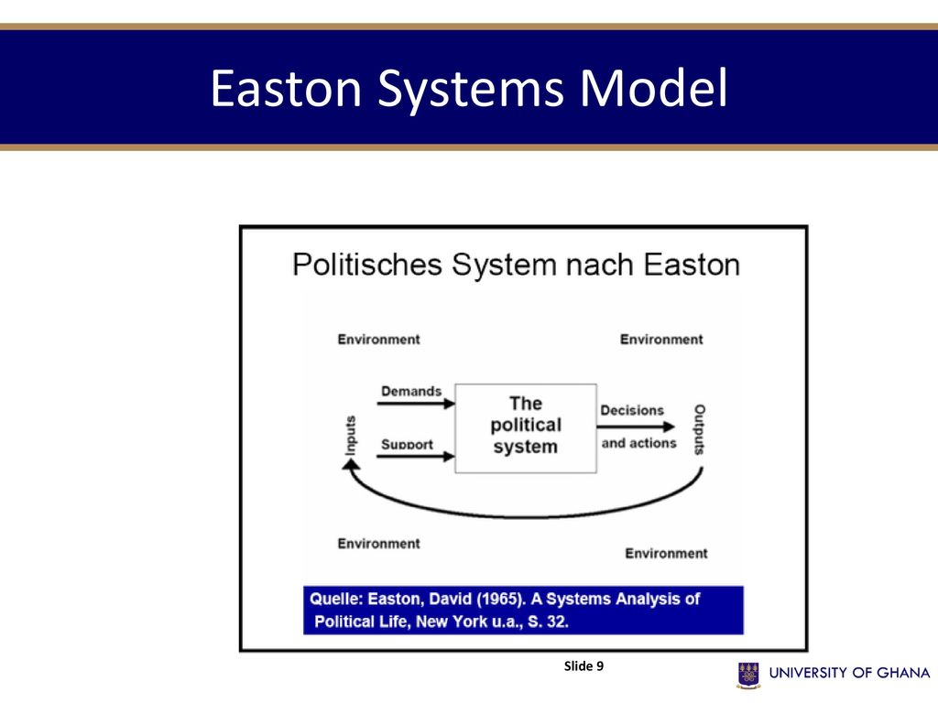
System Theory

Slide 3
What is a Political System
According to David Easton
A political system is a subsystem of the society which is concerned with the authoritative allocation of values
A system involves the interrelations of individual components
A political system is constituted by interactions that lead to the authoritative allocation of values
Ex. material values such as financial or symbolic values such as prestige and recognition
A political system exists in an environment: internal and external or intersocietal or extra societal

Slide 4
System Theory
The key principle behind the system analysis is equilibrium
At the heart of this equilibrium are input and output mechanisms

Slide 5
Components of a Political System
A political system is comprised of a governmental system
Legislature: Rule making
Executive: Rule application
Judiciary: Rule adjudication

Slide 6
How a political system works?
Input: Demand and support
Demand: claims for money, service, recognition, moral values, etc. Political systems need to filter demands and select worthy ones.
Demands originate within internal environment
Supports are the input of loyalty to the system
Support involves votes, paying taxes, maintaining law and order etc.
Support originates from both internal and external environments

Slide 7
Political system
Output:
Political decisions/ actions by the government or policies of political authorities
Feedback: when decisions are considered satisfactory by the society or citizens, they come back to the input as support to the government
When they are considered unsatisfactory by citizens or society, they come back to the demand side of the inputs

